Slide 1
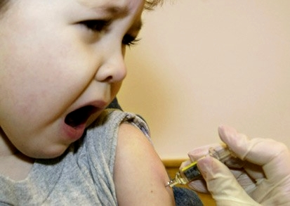
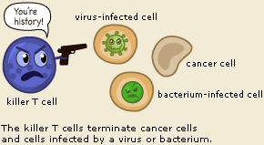
Lecture 12
Viral vaccines and immunity

Slide 2
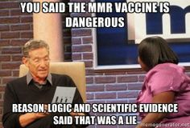
Viral vaccines
Overview
• What are viral vaccines?
- Parts of or whole virions that are injected into animals
for the purposes of inducing some immune response
• What are viral vaccines designed to do?
- Produce long-term B cell and T cell memory so that the
person is protected in case of a later infection
• Challenges to successful viral vaccine programs
- Mistrust and bad science
- Some viruses resistant to vaccine development
- Mutation rate, poorly immunogenic proteins, latency
- Improper completion of injection series
- Cost/distribution for third world

Slide 3
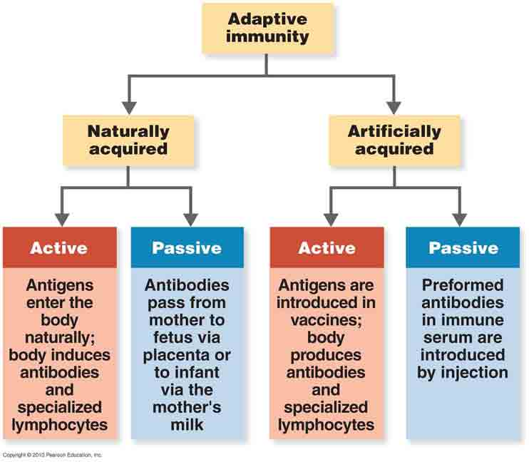
Viral vaccines
Considerations during design
• Active vs passive immunity
- Passive immunity
- Person receives already formed
antibodies or cytokines
- Happens naturally while in the womb
- Can be done artificially if person is dying of infection
- Fast response, but poor long term immunity
- Active immunity
- Immune system of person exposed to actual viral antigens
- Can be from natural infection or artificial vaccine
- Person develops full immune response → long-term
immunity

Slide 4


Viral vaccines
Considerations during design
• What type of immunity is needed?
- Some types of viral vaccines lead to great B cell responses,
others great T cell responses
- Have to know what type is most effective against the
specific virus
• How long is immunity needed?
- Some diseases primarily affect kids
- Don’t necessarily need lifelong immunity
- Some are only ineffective in the
short-term due to viral mutation
- Only need immunity for short time
- May need boosters to keep memory strong

Slide 5

Viral vaccines
Increasing immunogenicity
• Several factors determine how well a viral vaccine induces
a memory immune response
- Amount of viral antigen injected
- Too little and too much antigen can cause
a poor immune response
- Too much – desensitization effect
- Site of injection
- Viral vaccines can be administered IV, IP, nasal, IM
- Different sites → different lymphatic tissues get vaccine
- IV – antigen goes to spleen, IM – antigen to lymph
nodes
- Goal is to mimic natural infection as much as possible

Slide 6
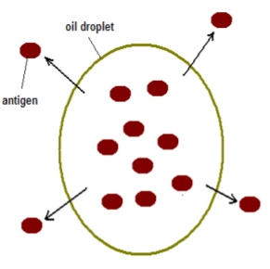
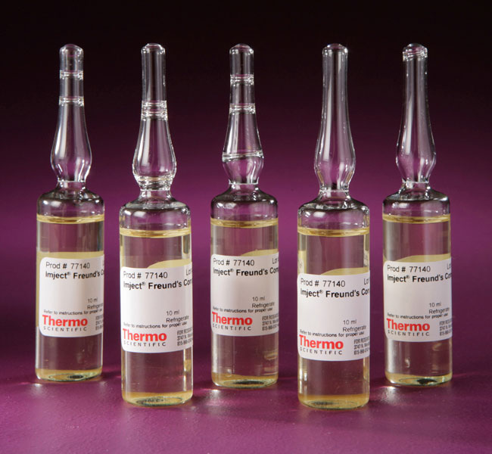
Viral vaccines
Increasing immunogenicity
• Some viral vaccines are naturally not very good
- Need ways of sparking a better immune response
• Adjuvants – chemicals added to vaccines to improve their
effectiveness
- Three major mechanisms of action
- Those that prolong persistence in body
- Include use of oil droplets (Freund’s
complete adjuvant)
- Those that increase rate of phagocytosis
- Cause virions to clump up
- Includes use of alum
- Those that spark inflammation
- Includes use of Mycobacterium “parts”

Slide 7
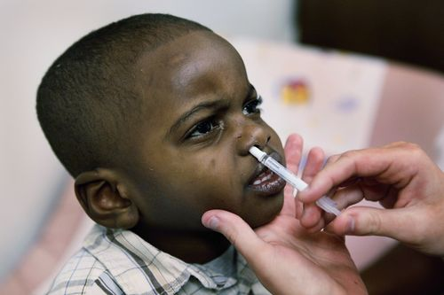
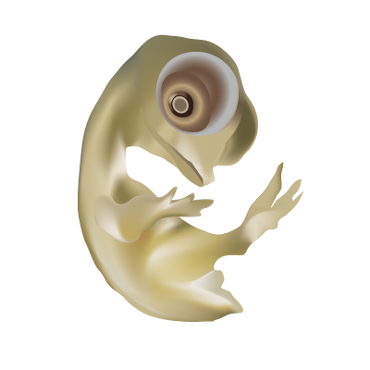
Viral vaccine types
Live attenuated
• Attenuation – Alteration of microbes in order to drastically
reduce their ability to cause disease in the host
- Keep it "alive" – allows for low levels of replication upon
inoculation
• Attenuation is achieved by:
- Growing the pathogen in an abnormal environment
- Pathogens mutate and become adapted to
replicate in these alternative environments
- Move back into humans → Fail to grow well
- Direct removal/mutation of virulence genes
- Can replicate, but no disease

Slide 8
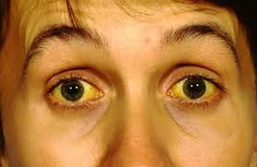
Viral vaccine types
Live attenuated
• Example: Yellow fever virus vaccine
- One of the most feared diseases in
history due to severity of the symptoms
- Hemorrhaging out of eyes, nose, mouth
- Black vomit and liver failure
- Early YFV vaccines were attenuated by growing them in
mouse brains
- Lost liver tropism (good), but gained neurotropism (bad)
- Max Theiler (1937) – grew YFV in cells derived from
chicken embryos that lacked nervous tissue
- 176th passage – mutation took place in virus that caused
it to ignore nervous tissue → Success (1951 Nobel)

Slide 9
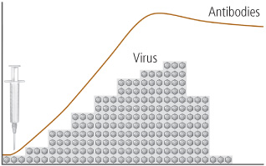
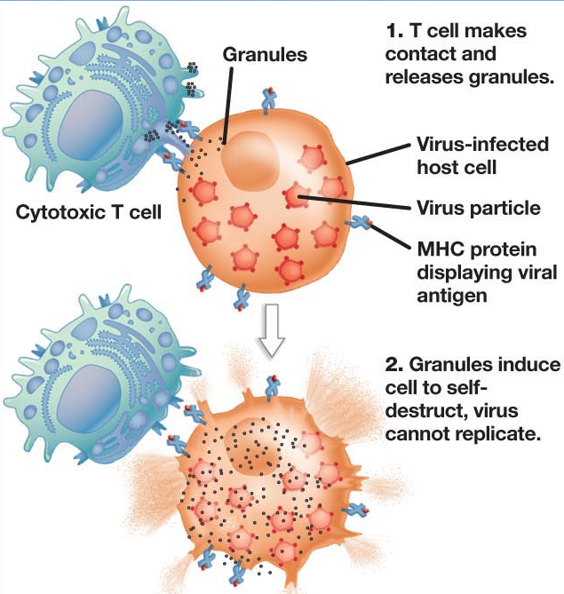
Viral vaccine types
Live attenuated
• Major advantages of live vaccines
- Transient growth mimics more of a natural infection
- Prolonged exposure leads to a greater immune response
and better memory
- Often just need a single
dose (no boosters)
- Very important in Third
World!!
- Virus goes to normal tissues
and proper 2° lymphoid
tissues involved
- Can get a good cell-mediated
and humoral response

Slide 10
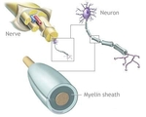
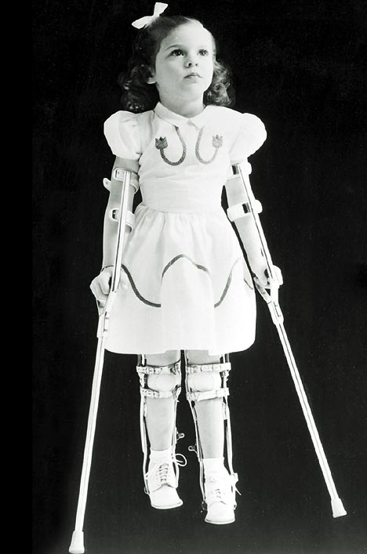
Viral vaccine types
Live attenuated
• Major disadvantages of live vaccines
- Can replicate enough to spread and cause
real disease symptoms
- Ex: MMR vaccine and measles-induced
encephalitis (1/million)
- Common w/ immunocompromised
- Can mutate back to virulent form and cause
severe natural disease
- That infected individual can spread it to
other unvaccinated individuals
- Ex: Sabin polio vaccine – virus re-entered
water supply in some Third World countries
- Vaccine requires prolonged refrigeration

Slide 11
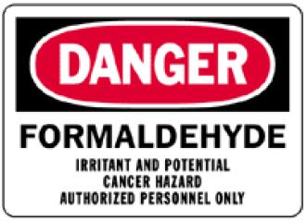
Viral vaccine types
Inactivated/killed
• Use heat or chemicals to destroy the pathogen enough to
prevent its replication (don’t want to destroy Ag though)
- Heat – often too much denaturation of proteins
- Common to use formaldehyde and alkylating agents
• Induces more of a humoral response (antibodies)
• Benefits
- Much safer than live vaccines
- Little risk of real infection (unless improperly inactivated)
- No refrigeration required (more stable)
• Drawbacks
- Fails to elicit long-term memory → frequent boosters
- Must be injected

Slide 12
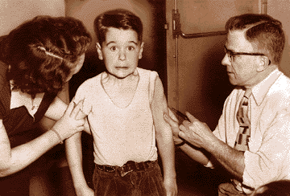
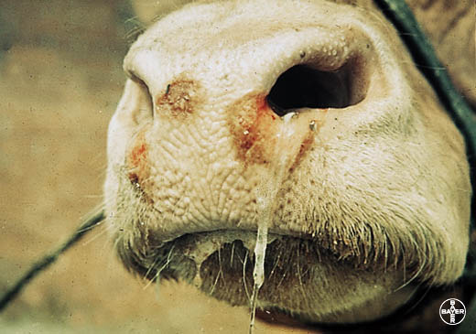
Viral vaccine types
Inactivated/killed
• Major problems can arise if whole virion vaccine not fully
inactivated
- Examples:
- Poliovirus (Salk) vaccine – 1955
- 4 million doses were improperly
inactivated
- 204 cases of paralytic polio, 11 deaths
- Foot and mouth disease vaccine – 1979
- Bad inactivation led to widespread
outbreak of FMD in France and UK

Slide 13
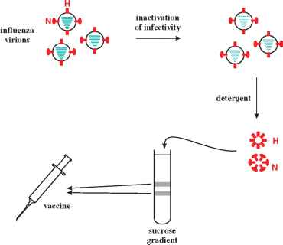
Viral vaccine types
Subunit vaccines
• Subunit vaccines – Injecting a purified virion protein into
a person in order to develop immunity to that product
• Developing an immune response against one virion protein
can help destroy entire virions
• Can be created in a couple of ways
- Express a virion protein in a cell and
purify it
- Inject just that one protein
- Take virions and destroy certain parts
- Inject just the parts that remain

Slide 14
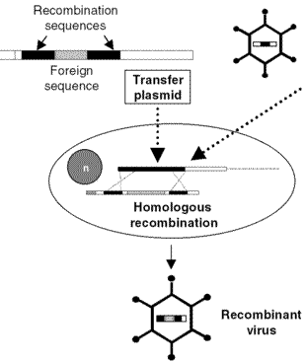
Viral vaccine types
Live recombinant vaccine
• Live recombinant vaccine
- Put gene encoding important virion
protein into the genome of a harmless
virus (e.g. vaccinia)
- Produce and purify those harmless
virions that are carrying the foreign DNA
- Vaccinate individual → their infected cells
will make the foreign virion protein
- Person will develop immune response against
both the viral vector and foreign virion protein
- Example: Rabies virus G protein made by vaccinia virus
- Inject into wild animals → develop antibodies against
rabies G

Slide 15
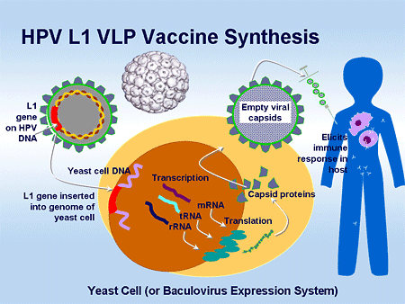
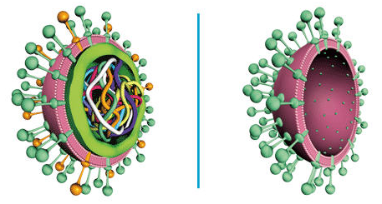
Viral vaccine types
VLPs
• Virus-like particles
- Parts of virions assembled into a
structure that resembles a virion
- Non-infectious b/c lacks genome
- Can be empty capsids
- Express proteins in a cell → they
spontaneously assemble in vitro
- E.g. HPV vaccine (major capsid)
- Can also be envelope + glycoproteins
- E.g. HBV vaccine (HBsAg)

Slide 16
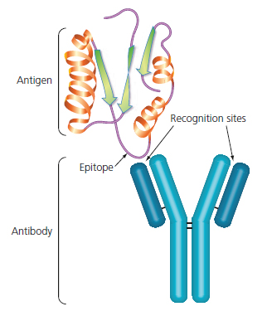
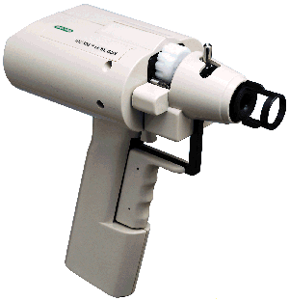
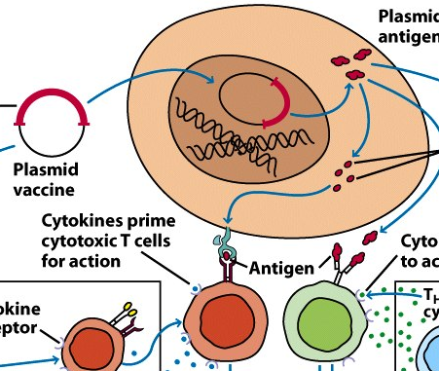
Viral vaccine types
Peptide and DNA vaccines
• Synthetic peptide vaccine
- Theory: Find the exact portion of a virion protein that
antibodies target (called epitope)
- Can make just that short peptide in vitro and inject it
- Antibodies would be created against just that epitope
- If that protein is on the surface of the virion, whole virion
indirectly targeted by antibodies
• DNA vaccine
- Inject a gene that encodes virion protein
- Host cells make the virion protein (as in
a normal viral infection)
- Immune cells come over to “infected” cell

Slide 17
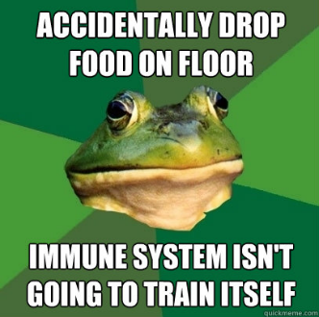
Host defenses against viruses
Overview
• Viruses represent a unique problem for the immune system
- Infect host cells → turns them “foreign”
- Incredibly small → not “eaten” well by immune cells
- Most have very few proteins on their outer surface
• Immune system general responses to viruses include:
- Identifying that a virion is foreign
- Differentiate a normal cell from one that is infected
- Kill the infected cell and destroy free-floating virions
- Do not kill normal cells nearby accidentally
- Secrete antibodies to attack any virions further away
- Create memory cells for future infections

Slide 18
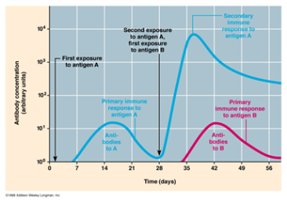
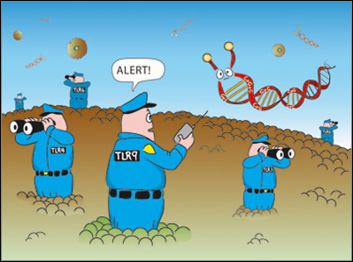
Host defenses against viruses
Innate vs adaptive
• Two major branches of the immune system
1) Innate immune system
- First line of defense against a pathogen
- Always present and ready for an infection
- Not specific for a particular pathogen – recognizes
microbial patterns (e.g. dsRNA)
- Response is immediate (within minutes-hours)
- No memory - response not better w/ repeated exposures
2) Adaptive immune system
- Extremely specific for particular molecules (antigens)
- Response time is slower (days)
- Response time gets faster if previously exposed to the
same antigen → has immunological memory

Slide 19
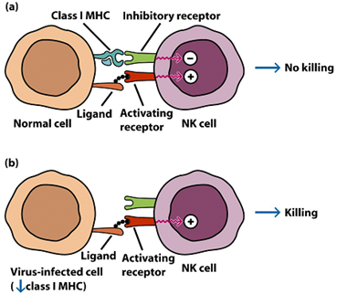
Host defenses against viruses
Innate defenses
• Two major innate anti-viral defenses exist:
1) Natural killer cells
- Target host cells infected with viruses rather than free
floating pathogens (also kill tumor cells)
- Prevents the cell from releasing millions of new viruses
- Identification of virus-infected cells
- Virus-infected (and tumor) cells express less of a
surface protein called class I MHC than normal cells
- NK cells recognize the abnormality and
kill their target host cells
- Doesn’t look for specific viral products
(b/c its innate)

Slide 20
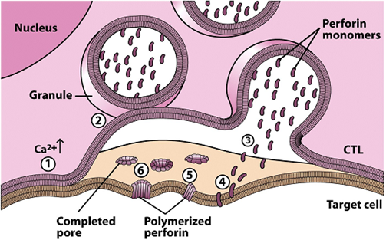
Host defenses against viruses
Innate defenses
• Two major innate anti-viral defenses exist:
1) Natural killer cells
- NK cells kill targets using:
a) Perforin and granzyme B
- Perforin protein is spit out by
NK cells onto the surface of
the infected host cell
- Perforin self assembles into a
pore → pops holes in target
cell membrane
- Important nutrients leak out → cell dies
- Pore also lets in granzyme B into target cell
- Activates cell suicide (apoptosis) caspase enzymes

Slide 21

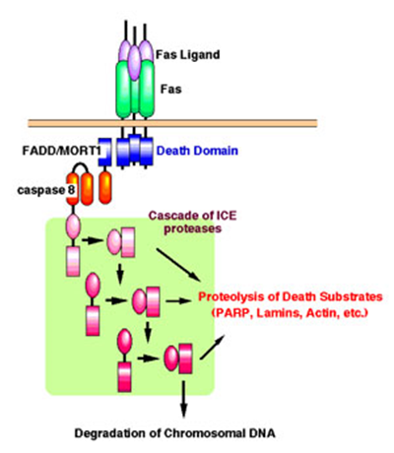
Host defenses against viruses
Innate defenses
• Two major innate anti-viral defenses exist:
1) Natural killer cells
- NK cells kill targets using:
b) Fas and FasL
- All cells express a protein on their surface called Fas
- Activated NK cells express ligand for Fas called FasL
- Binding of FasL to Fas initiates
signaling pathway
- End result: Caspases activated
in the target
- Caspases have variety of activities
- Destroy the cytoskeleton, fragment
DNA, destroy membrane

Slide 22
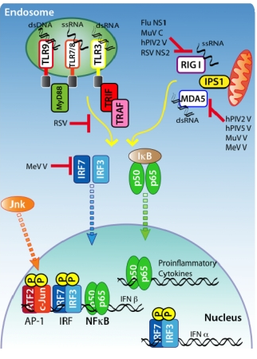
Host defenses against viruses
Innate defenses
• Two major innate anti-viral defenses exist:
2) Interferons
- Viral replication in cells creates
unique by-products (e.g. dsRNA)
that are recognized by special
cell receptors
- Called Toll-like receptors
- Induce a signaling event in the
infected cell
- Triggers anti-viral response in that
cell (e.g. slicer/dicer, PKR)
- Also causes cell to secrete IFNs

Slide 23
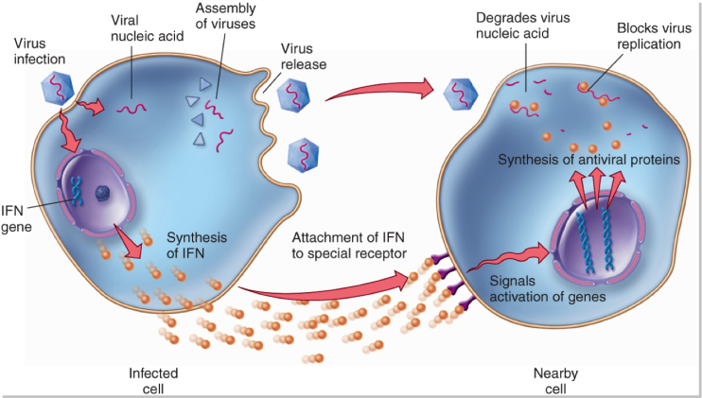
Host defenses against viruses
Innate defenses
• Two major innate anti-viral defenses exist:
2) Interferons
- Small cytokine released by
virally-infected cells
- Attaches to receptors on nearby
uninfected cells and induces a
signaling cascade
- End result: Cells turn on hundreds of genes that encode
various anti-viral proteins
- Block viral RNA synthesis
- Block translation
- Change membrane composition to block entry/budding
- Ribonucleases

Slide 24
Host defenses against viruses
Adaptive defenses
• Adaptive immune response centers around the activation of
B cells and T cells
- Divided into humoral and cell-mediated branches
- Humoral immunity – Defends the body against
pathogens that are free floating in the body fluids
- Mediated primarily by soluble antibodies that are
made by B cells
- Attack free-floating virions
- Cell-mediated immunity – Attacks body cells that have
been infected or are altered (e.g. cancer)
- Mediated primarily by T cells (cytotoxic T cells)
- Attack virally-infected cells

Slide 25
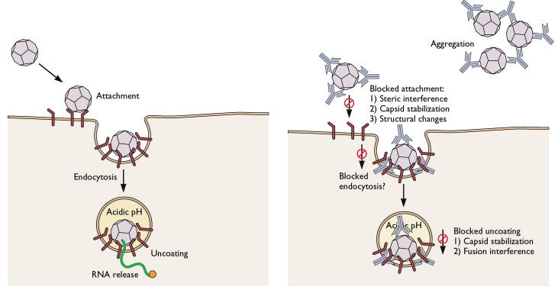
Host defenses against viruses
Adaptive defenses - antibodies
• Antibodies that are made by B cells are SPECIFIC to
a given viral protein
- E.g. antibodies against HIV gp120 or HSV gB
- They can attach to that free virions and neutralize them
- Block attachment to receptor, clump it up, block
uncoating

Slide 26
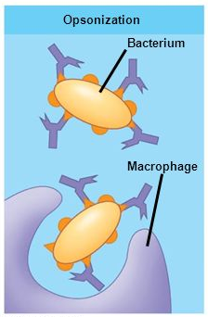
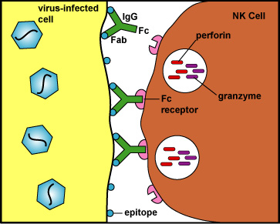
Host defenses against viruses
Adaptive defenses - antibodies
• Antibodies that are made by B cells are SPECIFIC to
a given viral protein
- Antibody attachment to virions can also
cause them to be eaten easier by phagocytes
- Antibody “tags” it for recognition
- Called opsonization
- Antibodies can also attach to virally-infected
cells and call over an NK cell
- Antibody is again “tagging”
the altered host cell
- NK cell kills it
- Called ADCC

Slide 27
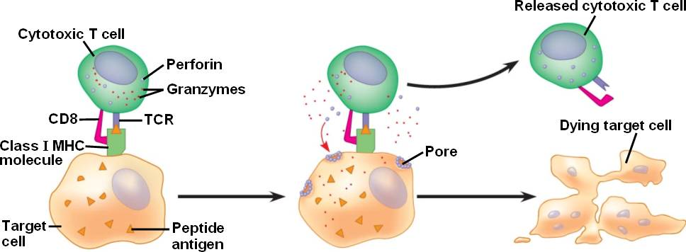
Host defenses against viruses
Adaptive defenses – Tc cells
• Cytotoxic T cells recognize specific viral antigens that are
being presented on the surface of infected cells
- Presented by a host protein called MHC
- Binding activates T_{C} cells to release granzyme B and
perforin
- Target cells (w/ virus inside) are killed

